Slide 1
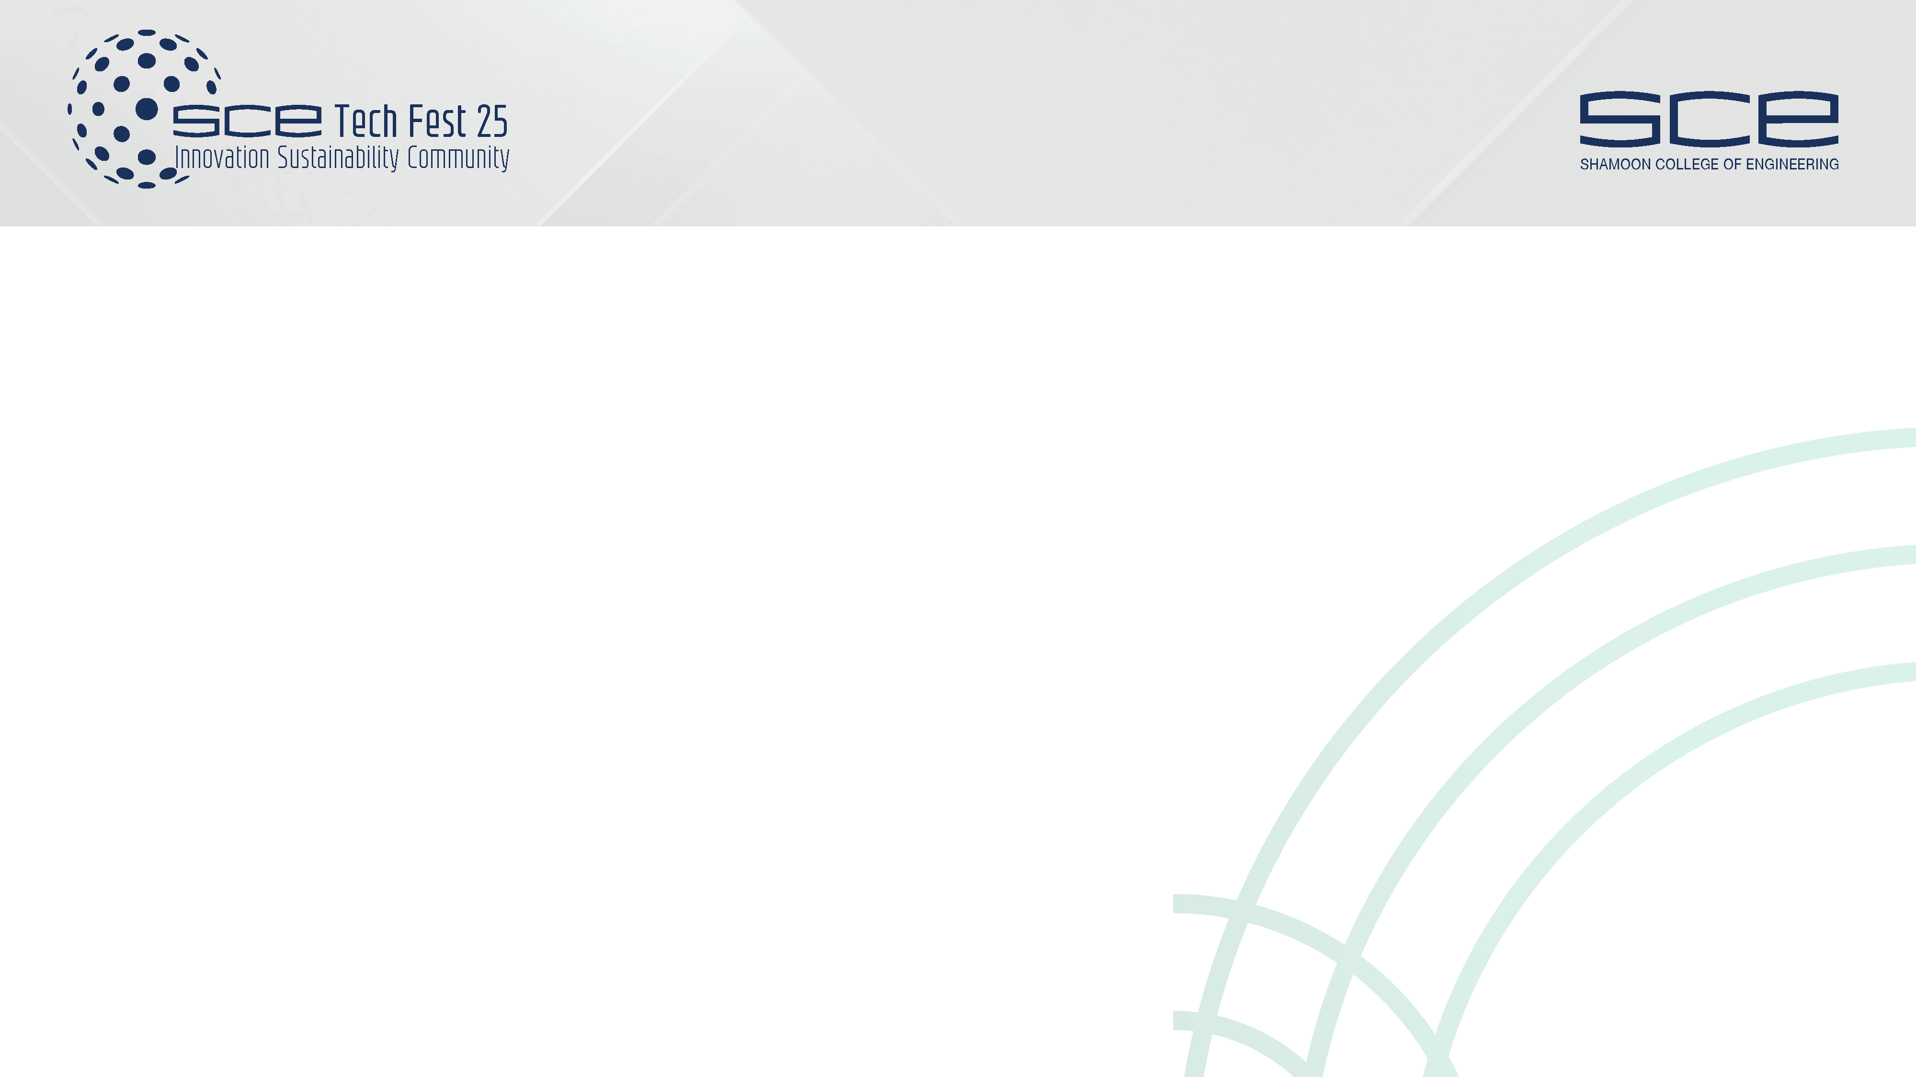




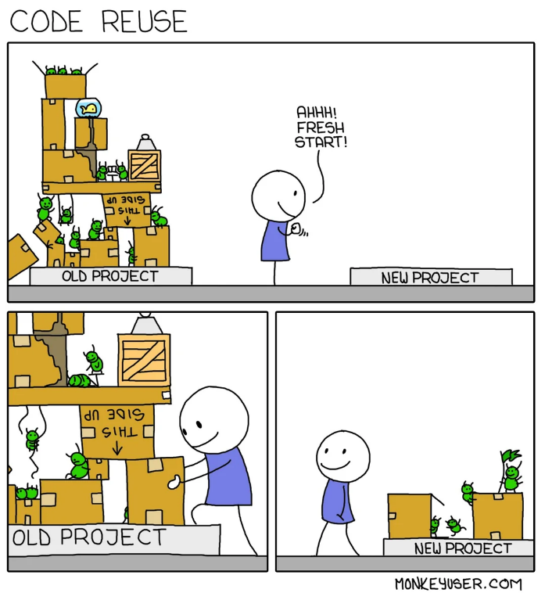


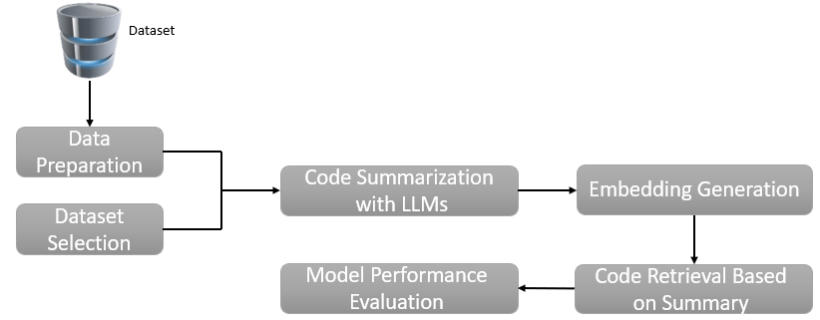
SE-D-6
Software Engineering
Students: Lior Gofman | Nir Kanimach
Advisor: Dr. Marina Litvak
RQ1: Can natural language summaries improve code retrieval performance?
RQ2: Which summarization model best supports effective software reuse?
Summarization Enhances Code Reuse by Improving Retrieval
Summary | Query | Code
… | … | …
CodeSearchNet Dataset
Generates natural language summaries for code snippets using fine-tuned LLMs.
Transforms code into semantic representations to improve similarity-based retrieval.
Enables efficient code reuse by comparing user queries to generated summaries, improving the accuracy and relevance of retrieved functions.

Slide 2

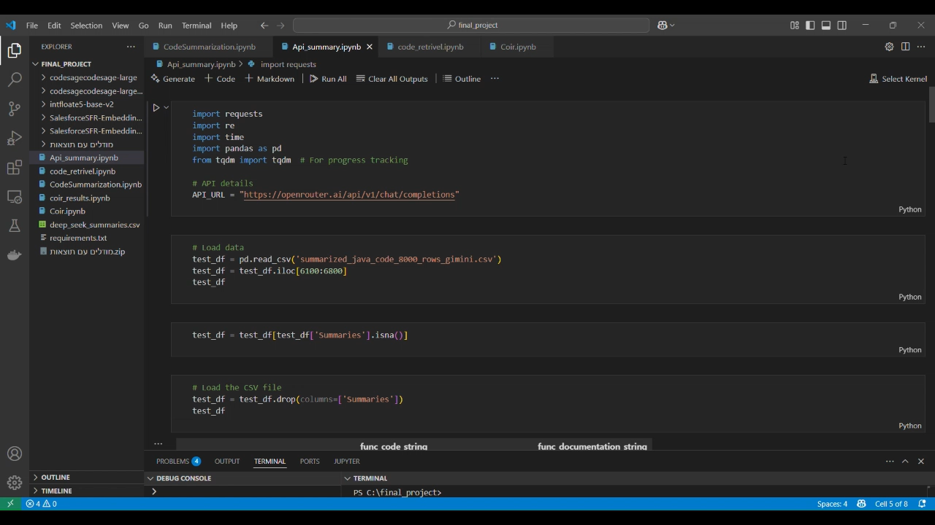
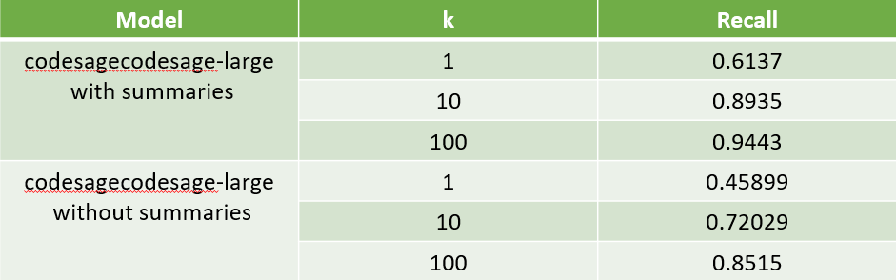
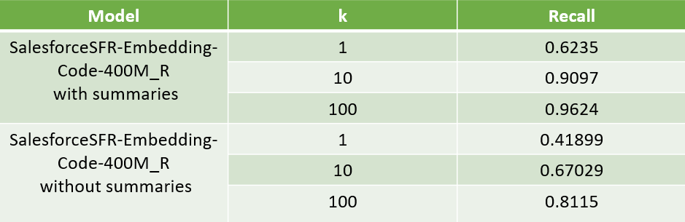

SE-D-6
Software Engineering
Students: Lior Gofman | Nir Kanimach
Advisor: Dr. Marina Litvak
Summarization improves retrieval accuracy Enables better query-to-code matching and enhances reuse efficiency.
Among all tested models, DeepSeek achieved the best retrieval results, making it the most effective for code summarization and reuse.

